Slide 1


School of Basic and Applied Sciences
Course Code : BBS01T1002 Course Name: Semiconductor Physics
E-K Diagram, Brillouin Zones
Name of the Faculty: Dr. Aakash Mathur Program Name: B.Tech

Slide 2
Topics to be covered
:
Preliminary ideas of Kronig Penney Model
Introduction
E-K diagram
Brillouin zones in one dimension zones
References

Slide 3
Objectives
Explain and apply E-K Diagram
Explain Brillouin zones

Slide 4
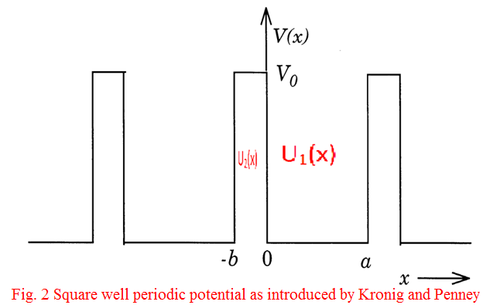
Prerequisite/Recapitulations
:
Kronig-Penney Model
For electron in a periodic potential it assumes that the potential energy of an electron forms a periodic square potentials of periods (a+b) such that
V(x) = V₀ for -b < x <0
= 0 for 0< x < a
This model, although idealised but very useful because it explains many useful periodic features of the behaviour of electron-lattices.
The wave functions associated with this model may be calculated by solving Schrodinger equations in two regions:

Slide 5
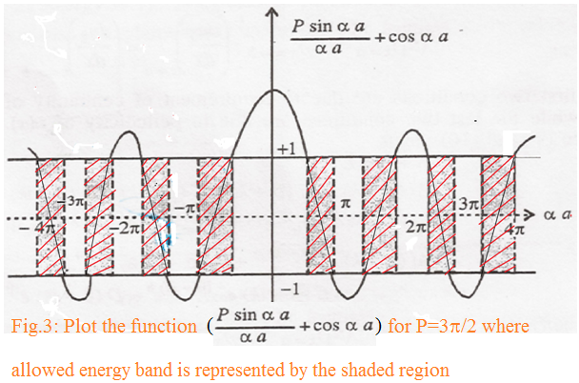
Prerequisite
:
Using boundary condition we can solve it to
the condition for the solutions of the wave equation to exist
where P=
P is a measure of the quantity V₀b, which is the area of potential barrier, called barrier strength
If P is large the barriers are strong. When P→∞, corresponding to a infinitely deep potential well, the electron can be considered as confined into a single potential well. This case applies to crystals where the electrons are very tightly bound with their nuclei.

Slide 6
Introduction
An E-k diagram shows characteristics of a particular semiconductor material.
It shows the relationship between the energy and momentum of available quantum mechanical states for electrons in the material.
It gives the idea of band gap (E_{G}), the difference in energy between the top of the valence band and the bottom of the conduction band.

Slide 7
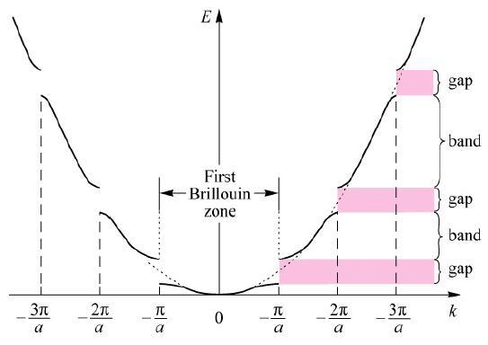
E-K Diagram
The electron moving in a periodic potential lattice can have energy values only between allowed regions or zones. With the help of equation
The R. H.S. of the equation (1) cos ka becomes ±1 for values of k=nπ/a and hence the discontinuities in the E versus K graph occur at k=nπ/a where n takes the values of ±1, ±2, ±3, --- etc.
The total energy E of the electron can be plotted versus the wave number, or the propagation vector ‘K’

Slide 8
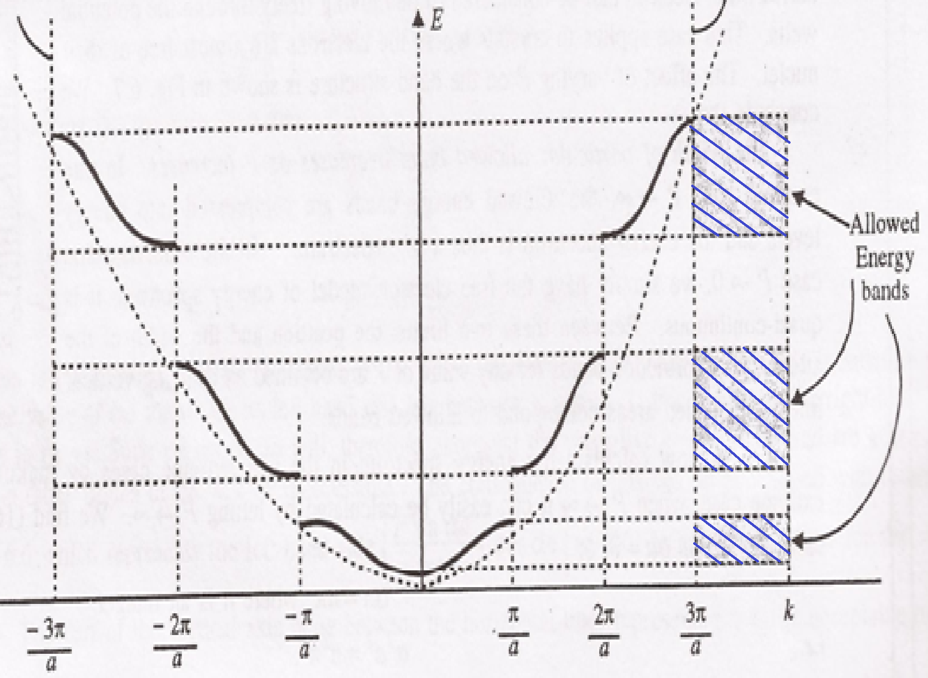
E-K Diagram
When P→0, corresponds to no barrier, the electron can be considered to be moving freely through the potential wells.
cos αa=cos ka i.e., α = k or α² = k²
E=
which is appropriate to the completely free particle. This shows that the allowed energy states of electron are continuous
The dotted curve shows the parabola of free electron i.e.,
.

Slide 9
E-K Diagram
In a periodic potential lattice, the electron energy values are discontinuous, separated into allowed and forbidden zones occurring alternatively.
The width of the forbidden band increases with E.
As P decreases, the discontinuous E-K graph will reduce to a continuous parabolic graph as shown by dotted lines and the forbidden bands disappear. This means that the energy values become practically continuous, when the perturbations of the potential due to periodicity of the lattice vanish, making electrons really free.
.

Slide 10
Brillouin zones in one dimension
In one dimensional periodic lattice, the energy discontinuities occur when the wave number k satisfies the condition k = nπ/a where n is a +ve or –ve integer. If we consider a line Fig 6, representing k values divided into energy discontinuities into segments of length ±π/a, then these line segments are known as Brillouin zones
The first segment is called the First Brillouin zone.
.

Slide 11
Practice Questions
Draw and explain E-K diagram.
2. Draw and explain Brillouin zones in one dimension

Slide 12
School of Basic and Applied Sciences
Course Code : BBS01T1002 Course Name: Semiconductor Physics
References
1. J. Singh , Semiconductor optoelectronics, Physics and Technology, Mc-Graw –Hill Inc. 1995.
2. S.M. Sze, Semiconductor Devices: Physics and Technology, Wiley 2008.
3. Pillai S O, Solid State Physics,( 2010), sixth edition, New Age International (P) Ltd. ISBN-9788122427264.

Slide 13
School of Basic and Applied Sciences
Course Code : BBS01T1002 Course Name: Semiconductor Physics
Thank you

